Slide 1
COLLABORATOR
By:
l.Manideep (160117737041)
m.Sruthakeerthi (160117737026)

Slide 2
INTRODUCTION:
Client needs a company to implement their work in an efficient manner. Companies need developers and there are many people who are interested in different domains also many developers wants to be hired with effective skills.
So the Collaborator web application acts as the platform to connect client and the company. Client pushes their requirement to the web application. The companies which are interested to take a particular work or project.
On the other hand, companies need developers and there are many people who are interested in different domains. The companies will recruit the developers according to the interest of the individual. So, everyone company, client and the developer will get benefited.

Slide 3
Motivation and problem statement
To create a web application which acts as the communication link between the Companies, Clients and Developers.
Developers are required by the companies and the companies are required by the developers indeed.
Clients need a company to work on their project.so this web application benefits the Clients, Companies and the developers.

Slide 4
Existing Systems
Recruiterbox : Recruiterbox helps growing companies hire simply and predictably. Most recruiting software is so clunky and cumbersome that people often relapse to using email and spreadsheets. Recruiterbox intends to change that. We understand that hiring works best when people collaborate and make informed decisions together. Which is why we designed Recruiterbox to get out of your way and get this job done..
Hireology:The all-in-one hiring and talent management platform for businesses of all sizes. Centralize your hiring process to save time and build your best team integrations to your existing HR systems like payroll, onboarding , scheduling, And that's all been thanks to the help Hireology provided to us in creating that website.
UltiPro is a product of Ultimate Software which is a leading cloud provider of human capital management (HCM) applications. The award-winning UltiPro offers HR, compensation, talent, payroll, and time and labor management apps that connect people with the resources and information they need to work more effectively.

Slide 5
Proposed system
The existing systems have only hiring of the developers but not the clients collaboration. Proposed System has both.
The Collaborator is the web application which acts as the interface between the Companies Clients and the developers.
Companies, Clients and developers need to register in the corresponding category so that they will be able to get contacted from the appropriate category members.
Developers need to upload their resume so that their skills will be extracted from them for showing the same to the companies. If the company needs the person with skills then the developer will get a notification that the particular company wants to hire him.
Clients need to provide their requirements so that companies will get their details. If the company accept their proposal then the client get the notification that particular company liked your proposal and they can contact each other through mail or phone call.
All the details of the companies clients and developers are stored in the database and will be provided whenever required.

Slide 6
Software and Hardware requirements
Django
Python
Postgresql
Visual studio
Html
Css
Javascript
Jinja2
Computer system

Slide 7
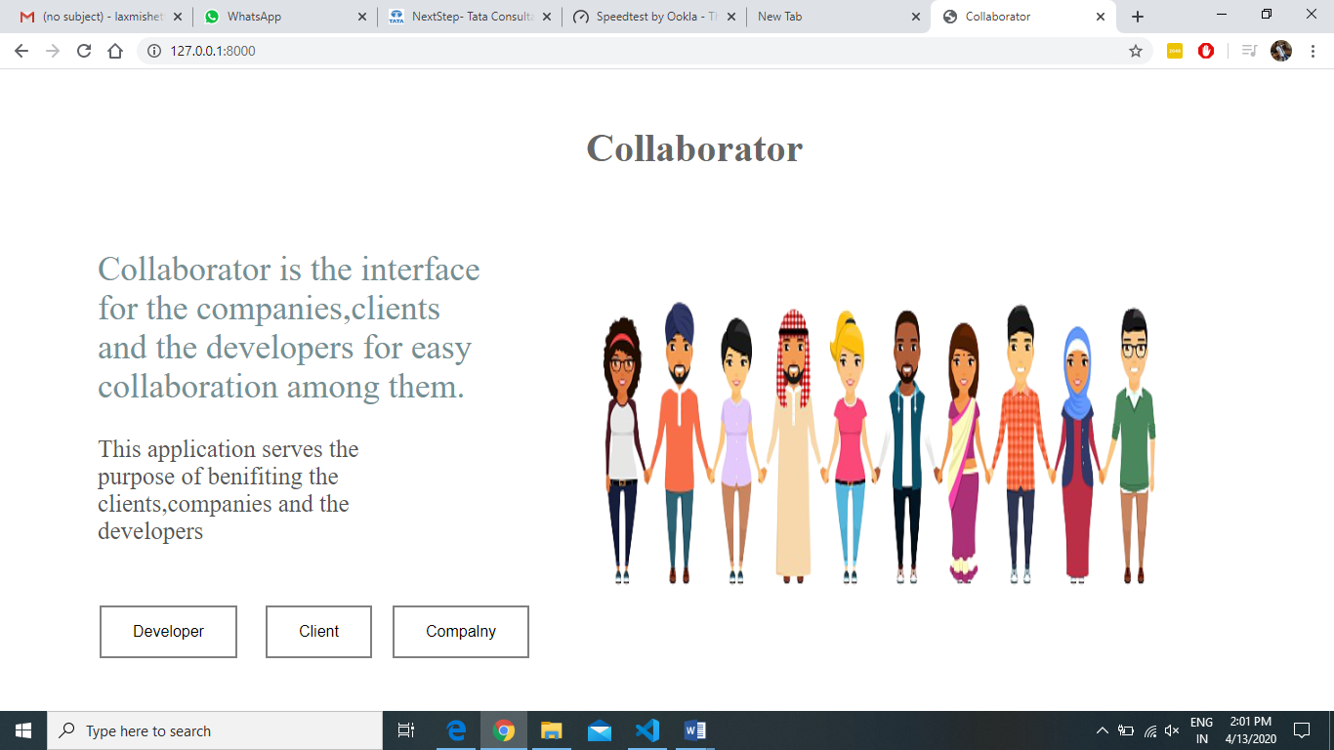
Result

Slide 8
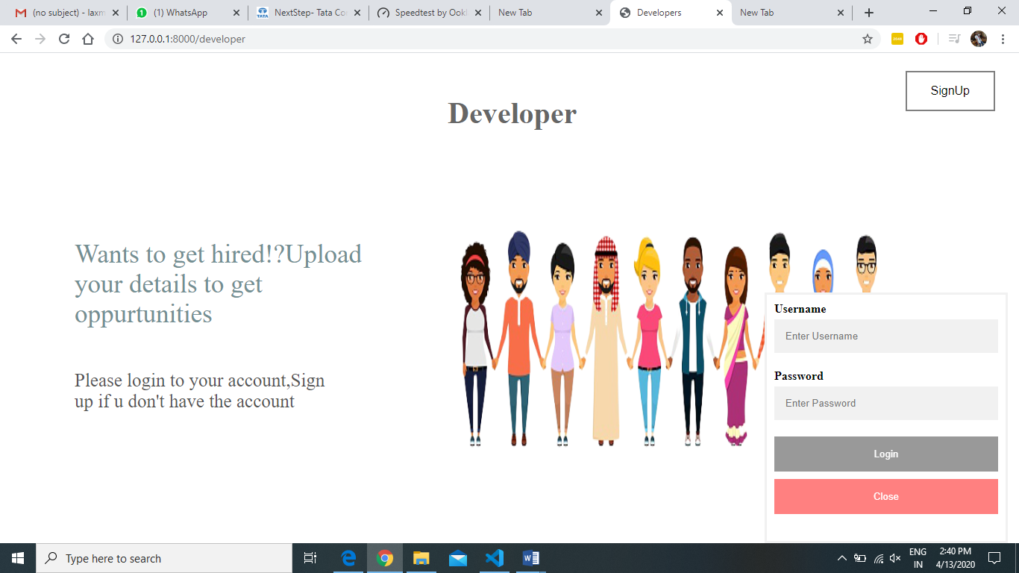
Result

Slide 9
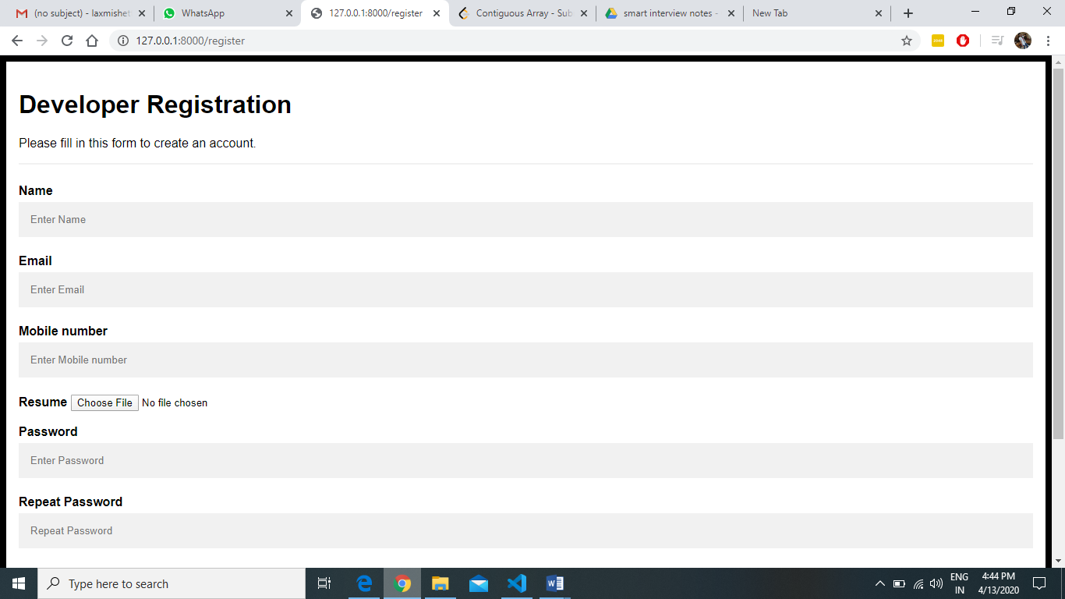

Slide 10
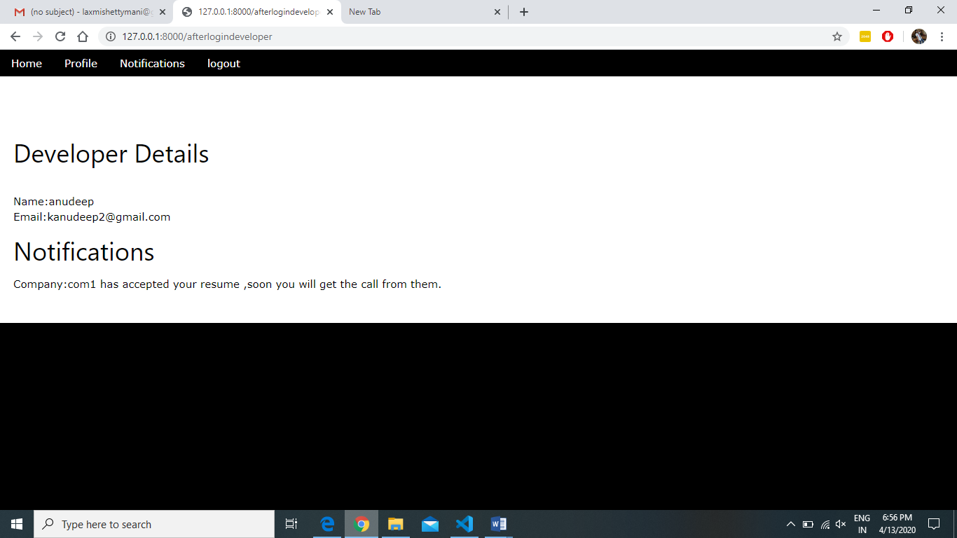

Slide 11
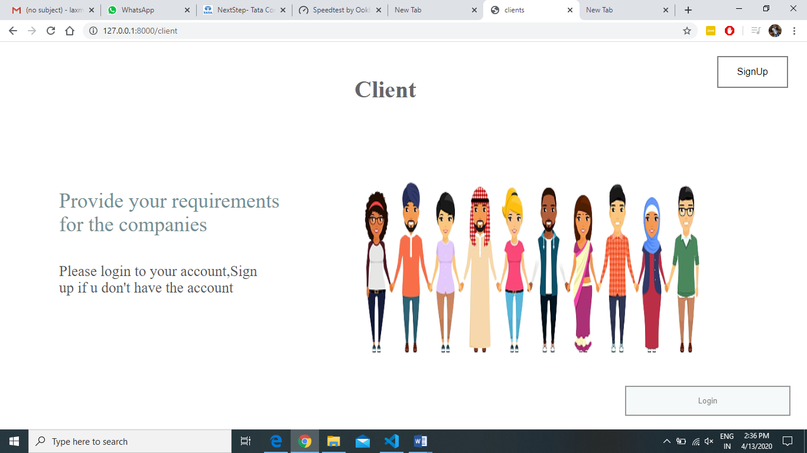

Slide 12
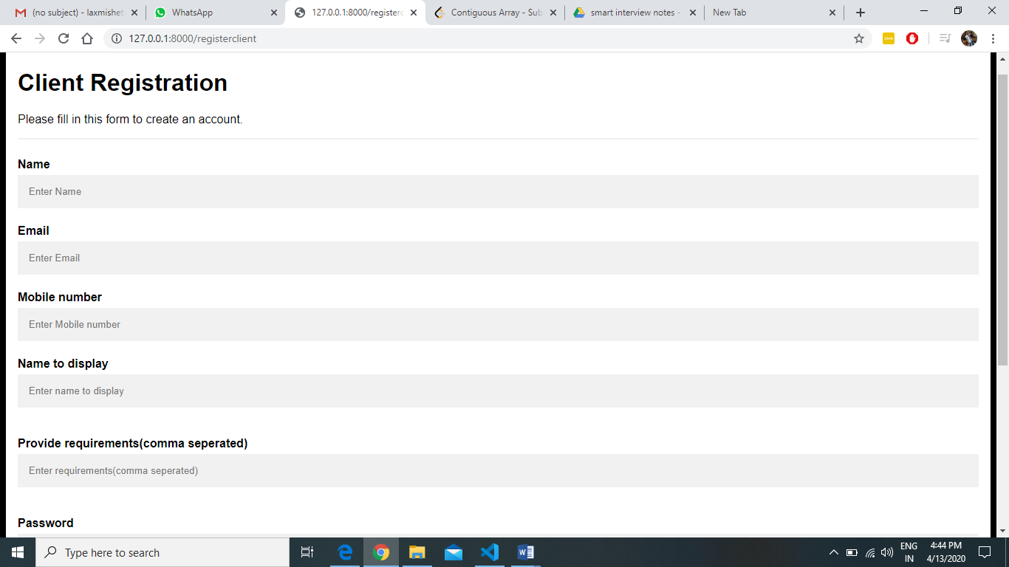

Slide 13
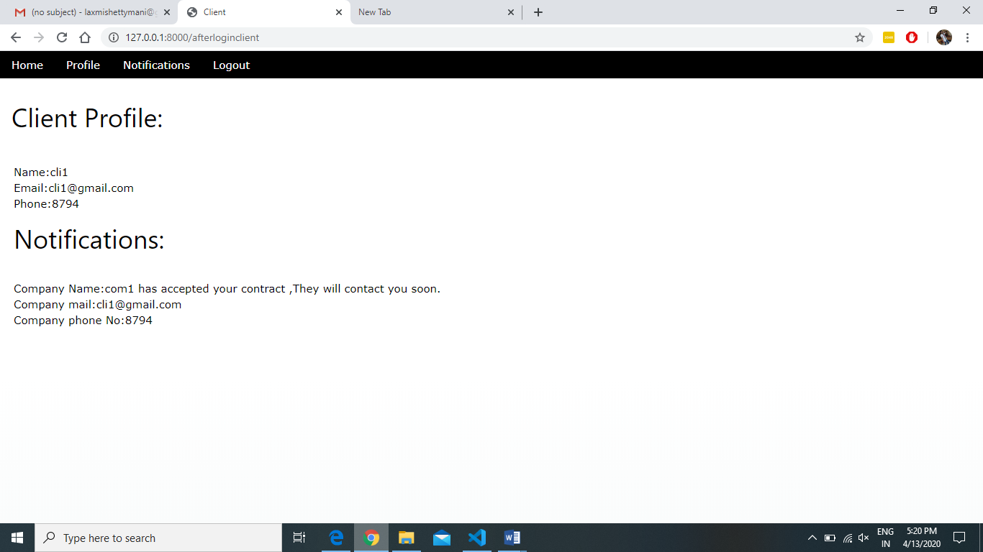

Slide 14


Slide 15
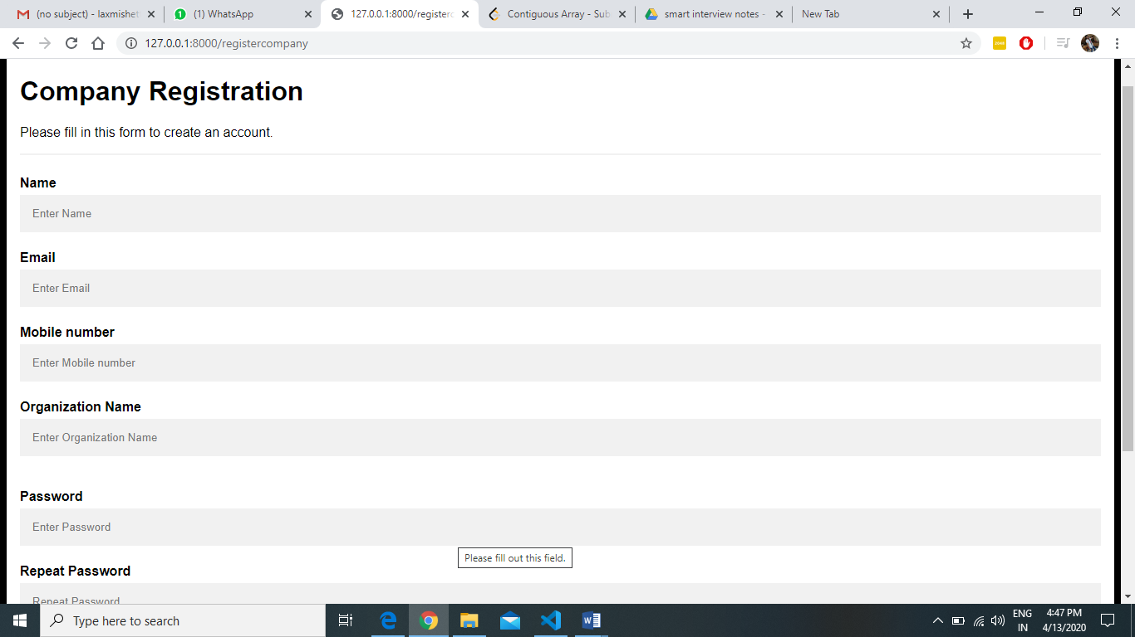

Slide 16


Slide 17
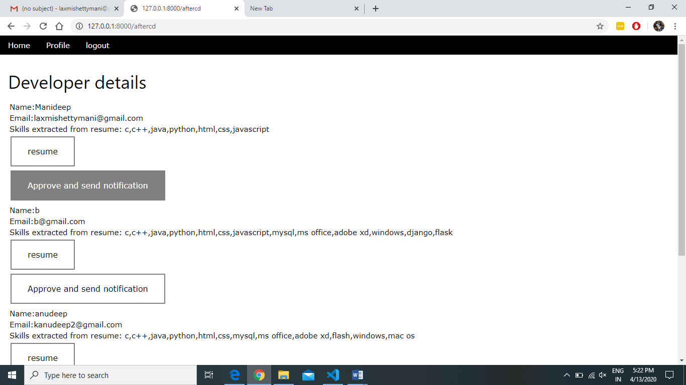

Slide 18
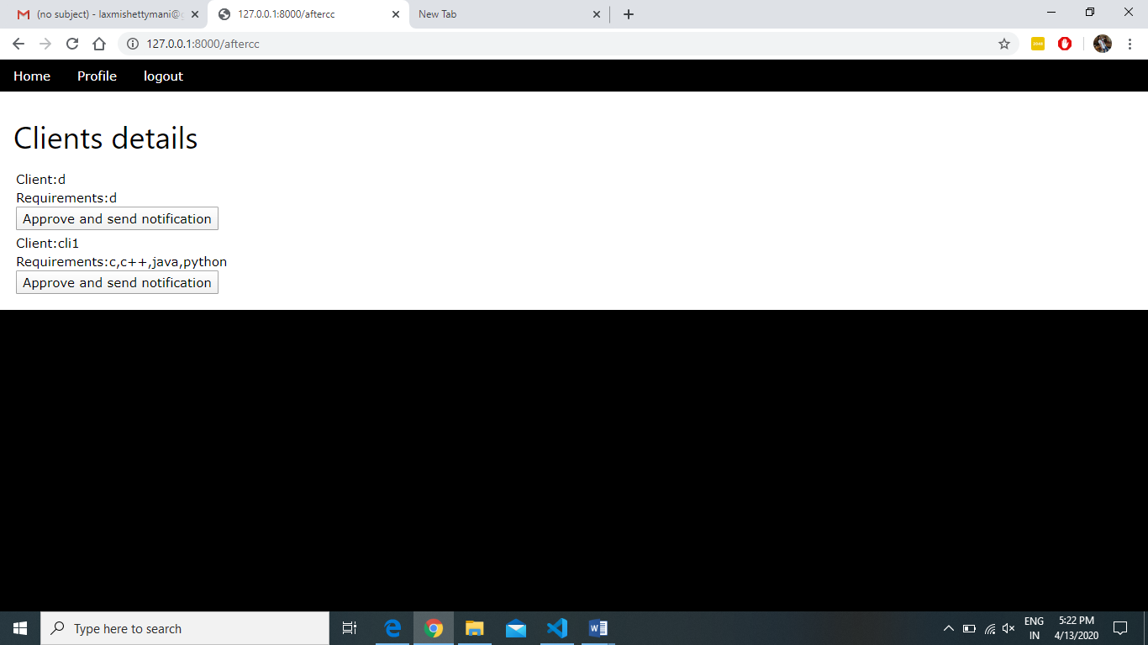

Slide 19
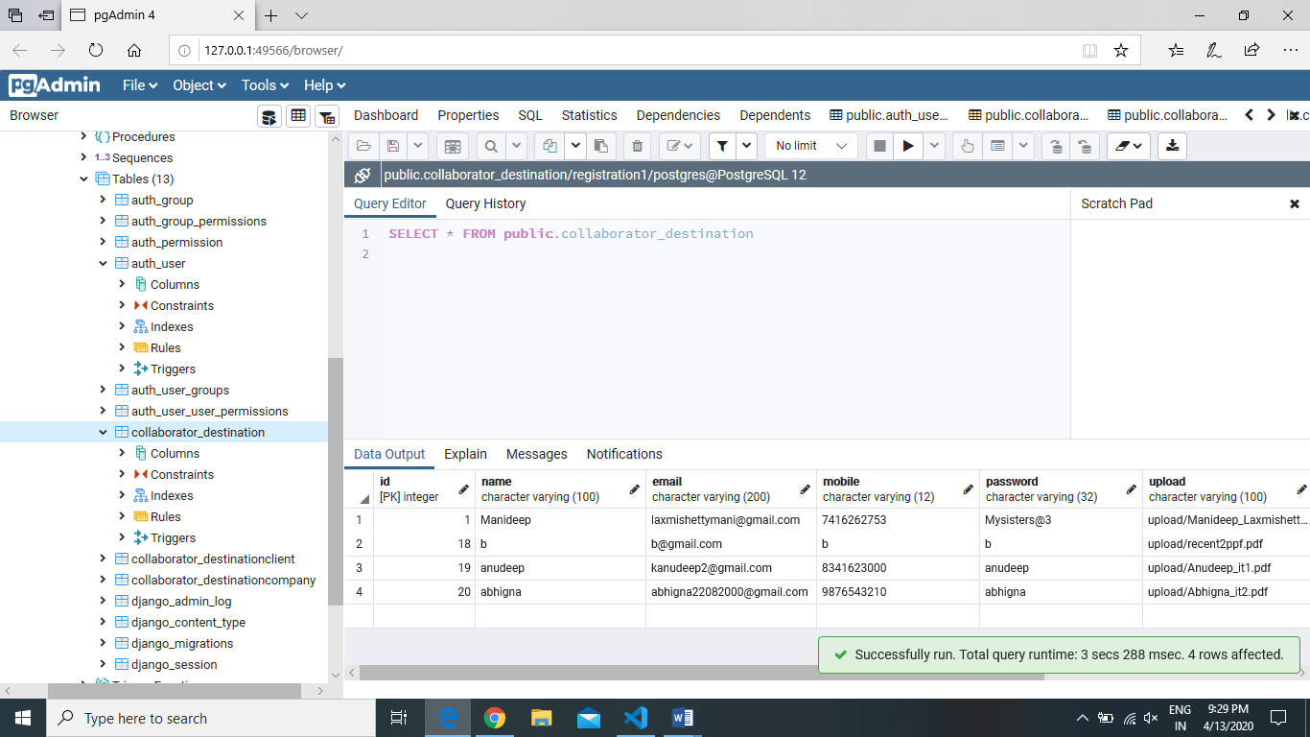

Slide 20
Conclusion and Future Scope
The collaborator web application acts as the platform to connect client and the company. Client pushes their requirement to the web application. The companies which are interested to take a particular work or project.
On the other hand, companies need developers and there are many people who are interested in particular domain. The companies will recruit the developers according to the interest of the member. So, everyone company, client and the developer will get benefited with the user friendly collaborating application.
Many things like chat-bot, communication through messages, calls, emails can be send directly among companies, clients and developers

Slide 21
References
https://www.w3schools.com/js/
https://www.geeksforgeeks.org/javascript-tutorial/
https://developer.mozilla.org/en-US/docs/Learn/HTML
https://www.google.co.in
https://www.w3schools.com/
https://www.tutorialspoint.com/
https://docs.djangoproject.com/en/3.0/
https://stackoverflow.com/

Slide 22
THE END

